Slide 1

Community Friday | September 4, 2020
Sustaining Student Engagement
September 2020

Slide 2
Student Affairs Approach
Recognize that sense of belonging is more important than ever
Be intentional
Don't over program
Collaborate across departments/campus
Empower students to build meaningful communities

Slide 3
New student Orientation
NSO Ambassadors
Purpose was connect new students with returning students
Role will carry into the first six weeks of class to maintain engagement with first year students
NSO groups
Each group comprises of 3-4 tutorials
Focus was on building communities
Creating community
Utilized icebreakers and teambuilders
Shared experiences
Virtual programming
Started during NSO and included Drag Race Bingo, Murder Mystery Night, Virtual Caricatures
Student Involvement will be hosting virtual events every Wednesday night, check the DSA Facebook page for more information
Saturday, September 5th at 9:00 p.m. CST magician Peter Boie will perform
Free to all students, information was sent via email
September 2020

Slide 4

Student Government Association
& SPARC
Student organization re-registration
Student Organization Fair
Student organization programming
Student organization meetings
Student publications

Slide 5
Intercultural affairs
Stonewall Resource Center
Focused Community Hours
Gender Affirming Supplies
E-Resources
Art related creative engagement
Student Org support
Black Cultural Center
Men of Color Empowered and Engaged
Black Womxn's Group
Young Alumni Spotlight Series
Student Org support
Multicultural Leadership Council
Developing virtual trainings
Student Org support
Programming Partnerships
Writers @ Grinnell
Grinnell College Museum of Art
Faculty and Staff of Color Caucus
SGA
Student Involvement
Individual Student Case Management
Connecting students to peer leaders
Relationship building
Community Friday
September 2020

Slide 6

Scurries
On-Campus
Off-Campus
Global

Slide 7
Best Practices
Get your students talking at the beginning of class/meeting
Small groups
Check-ins and icebreakers: building community
Identify the student's preferred form of outreach/communication
Clear communication and expectations
Use silence as a tool
Share your own experiences
Consider relationship building a priority
Be creative and open to new ideas

Slide 8
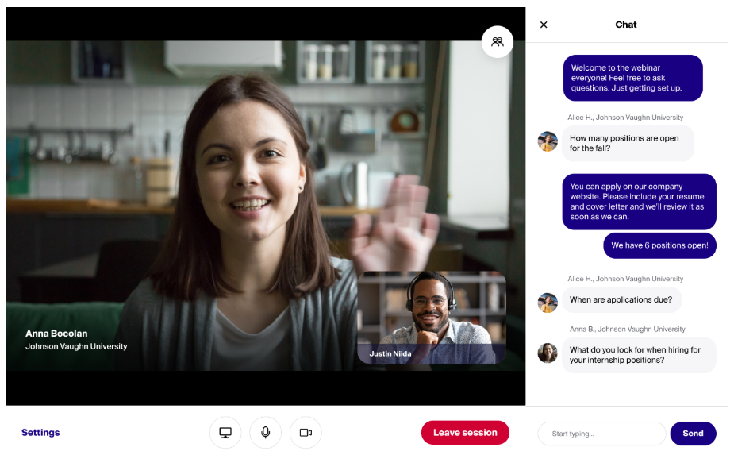
Careers, life & service
Advising, Programming & more…
Student Assessment & Learning Goals
Flexible Formats & Accessibility
Group Advising/Programs
Individual Outreach
Community Friday
Summer 2020
Notes:
Student Assessment
Will be administering a student survey to collect programming preferences and interests from students as well as self-assessment data
Focus on student learning goals – How might we accomplish the goals from this signature program in a different way?
Flexible Formats & Accessibility
Career Communities - Day in the Life series
Live events; recorded webinars; blog posts; podcasts (some modes are data/streaming heavy, others less so)
Videos posted on YouTube channel and GrinnellShare
Bolster “just-in-time” online resources
Employer Engagement: virtual fairs; video interview days
Time zone considerations
Ensuring our resources are accessible
Group Advising/Programs
Engaging in activities in community
Building support systems among students
Fostering connections between students and others (alumni, recruiters, etc.)
Individual Outreach

Slide 9
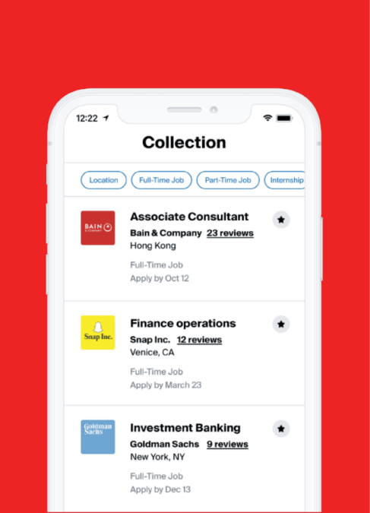



Careers, Life & Service
Communications
Web Site & Intranet
Weekly Newsletters
Handshake → App
Social Media
Community Friday
September 2020

Slide 10

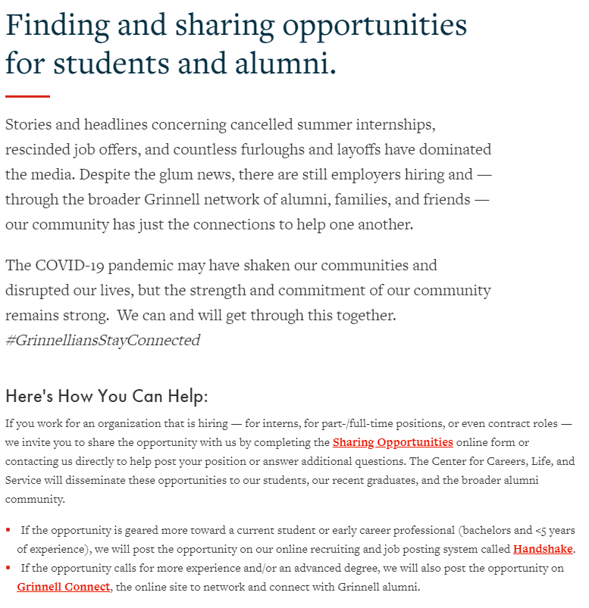
Careers, Life & Service
“Sharing Opportunities” Initiative
Internships
Part- & Full-time Positions
Contract roles
#GrinnelliansStayConnected

Slide 11
Questions
Spring 2020

