Slide 1
Support and Empowerment for Pedagogy & Technology
Community Friday
July 17, 2020

Slide 2
Panelists
Schvalla Rivera, Associate Vice President for Diversity and Inclusion, Chief Diversity Officer and Senior Advisor to the President
Autumn Wilke, Assistant Dean for Disability Resources
Sondi Burnell, Coordinator of Assistive Technology
Dave Robinson, Chief Information Officer
Peter-Michael Osera, Assistant Professor of Computer Science

Slide 3
T.H.R.I.V.E. Principles
The T.H.R.I.V.E. principles are:
Talk to improve transparency,
Health and safety must remain a top priority for our entire campus community,
Re-imagine and reconsider what is possible and necessary,
Inclusion requires flexibility,
Value all experiences of vulnerability,
Empathy requires all of us - and especially leaders - to be aware, sensitive, and responsive.

Slide 4
Accessibility: Background
Students with disabilities are approximately ~20% of the student body
Accommodations for online learning may be different than what some students used/needed in person. This transition may be an additional burden for students.
Students may have picked Grinnell specifically because of its semester residential model and how that would support their specific disability.
Many people are struggling right now with motivation, organization, etc. This may be exacerbated for students whose disabilities already impacted these executive functioning skills.

Slide 5
Accessibility: Assistive Technology
Assistive Technology and Disability Resource team will reach out and work closely with individual faculty who have students with course accommodations.
We will assist faculty with making sure their course materials are remediated to the required accommodation.
We are also able to consult with any faculty who have questions regarding specific accommodations or the best way to make specific elements of a course accessible.

Slide 6
Accessibility: Create a central repository for course materials
Use a course management system - Blackboard (PioneerWeb, or PWEB).
Assistive Tech and course support resources (ASAs) enroll to support.
Secure/privacy vetted.
Easy student access for other college resources like Library e-reserve, and databases.

Slide 7
Accessibility: Captioning for audio
Open Captions/Transcriptions or closed-captioned recordings of class lectures or meetings.
Webex Closed Captioning does this automatically when you save to the cloud. It can take up to 24 hours to receive the captioned video. You will receive an email notification when the video is ready to view, but not necessarily ready with captions. Be sure to verify the captions.
Otter.ai- for Artificial Intelligence (AI) speech-to-text for synchronous instruction. You can individually sign-up for a Free account. This way the transcription will be saved to your account for retrieval.
Microsoft Teams does AI captioning for live meetings. (New)

Slide 8
Accessibility: Readability
All course materials: textbooks, handouts, PowerPoints, even on-line journals need to be readable by a screen reader. (We also call these Readable PDFs, and Accessible PDFs)
Going through the Academic Support staff, using the library course e-reserve system, all materials are accessible to screen readers.

Slide 9
Accessibility: Audio
Use the ITS microphone, in your remote kit, every time to communicate, whether that’s on-line instruction or meetings.
Required for CART services, if accommodation.
Helps to produce more accurate transcriptions for Assistive Technology speech-to-text software: i.e., Otter.
In cases where students have inadequate internet service, suggest students use audio only.

Slide 10
Accessibility: Additional help
Remember that ITS-approved software has been reviewed for accessibility compliance.
(UDL) Universal Design Learning- is a way of thinking about teaching and learning that helps give all students an equal opportunity to succeed. This approach offers flexibility in the ways students access material, engage with it and show what they know. UDL-aligned strategies and guidelines help remove barriers in instruction so that all students can achieve their learning goals.
Visit Disability Resources Grinnell Share site: “Effective Classroom Practices Guided by Universal Design Learning (UDL),” for other inclusive tips.

Slide 11
Announcements

Slide 12
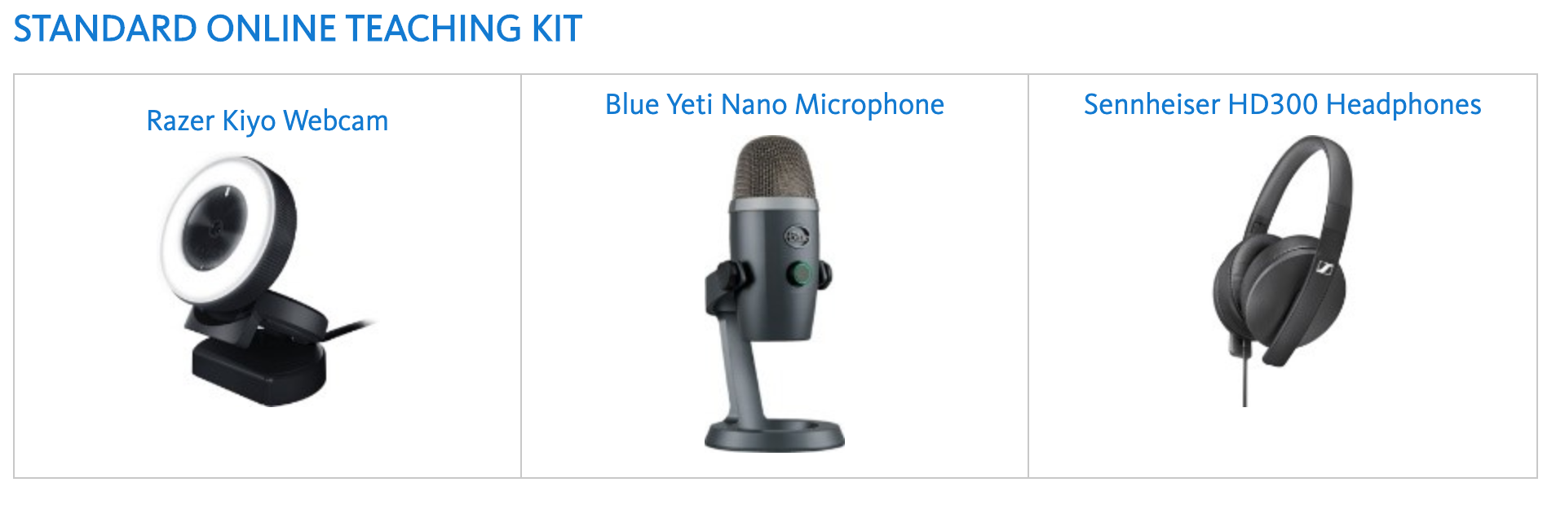
Teaching Kits
See more online: https://grinco.sharepoint.com/sites/its/SitePages/Online%20Teaching%20Kit.aspx

Slide 13
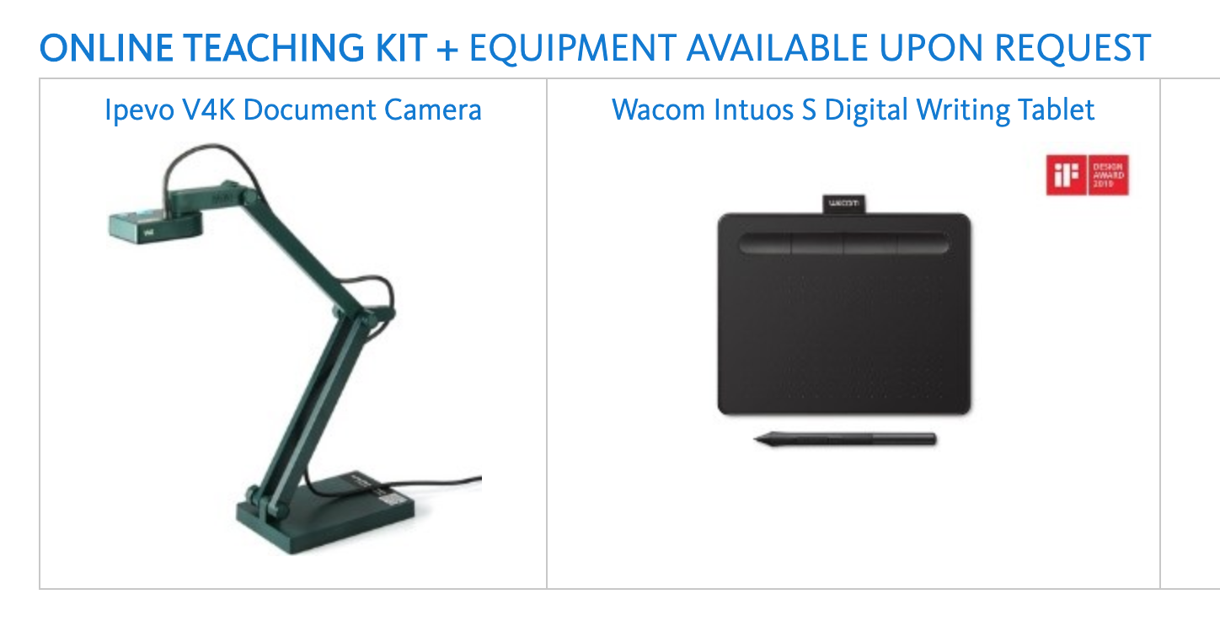
Teaching Kits
See more online: https://grinco.sharepoint.com/sites/its/SitePages/Online%20Teaching%20Kit.aspx

Slide 14
Teaching Kits
Standard kit includes a high quality webcam (with integrated illumination); high quality microphone; high quality headphones
Use for live communications as well as recording
Strongly advise all faculty to take advantage of them to ensure the best possible experience for students
All teaching faculty can request one (use the technology request form)
Kits are not all in yet but once they are ITS will reach out to those who requested one; can be collected from campus or mailed home if necessary

Slide 15

Pioneer Bookshop: Textbooks
Textbook information should be sent to the bookstore for both Fall 1 and Fall 2 by July 24. Include other course materials such as lab books.
You should have received a personalized link to your class adoptions from the bookstore on Monday, July 13. If not, email bookstore@grinnell.edu.
All required textbooks must be listed on the bookstore site to comply with the Higher Education Opportunity Act, no matter where the students buy them.
Your books will be offered in both physical and digital formats (when available).
The bookstore will ship books to students who are learning remotely, if they prefer a physical book.
We work with publishers’ representatives to negotiate the best prices. Please direct publisher rep. inquires to the bookstore.

Slide 16
Library: E-reserves
Submit e-reserve requests for Fall-1 ASAP
Submit all requests through your Academic Support Assistant
Give a “date needed” for the reading
Use ebooks or journal articles with fulltext available through the Library whenever possible (faster & cost-effective)
Include scans of needed sections/chapters if you have them
No physical books on reserve this fall
Copyright: we have additional Fair Use rights during pandemic, so we will post more content on ereserves

Slide 17
Library: Streaming Video
We are adding some large new collections (more on this soon)
While we are offering distance learning, we will be able to offer streaming versions of items currently only available in our VHS and DVD collections
Caveats, fine print, and request processes all to follow! More details will be shared as quickly as possible. This service will be available for F1.

Slide 18
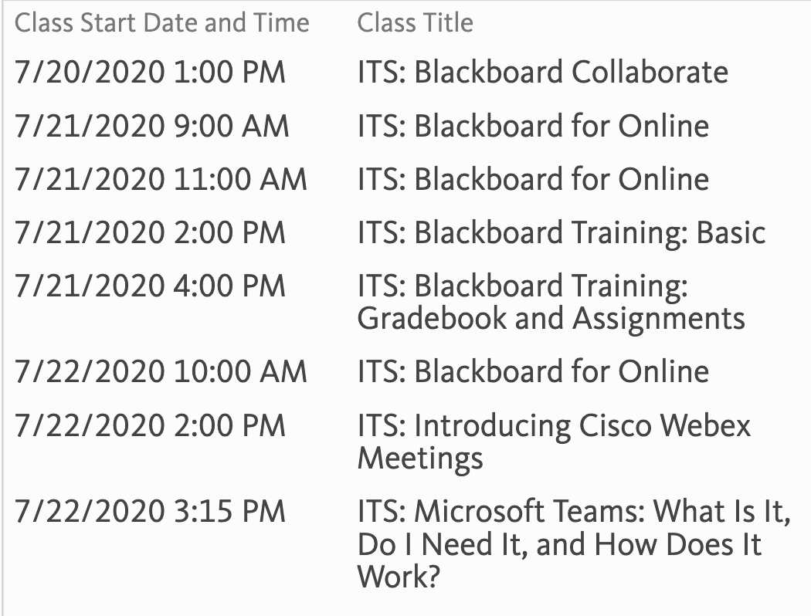
Upcoming Trainings through ITS
More options available on ITS’ GrinnellShare site: https://grinco.sharepoint.com/sites/Training/SitePages/Home.aspx

Slide 19
ITS Important links
ITS on GrinnellShare
Software Request Form
Special technology requests for the coming academic year
FERPA Do’s and Don’ts for remote work
FERPA Resources

